Slide 1

Project Potpourri
B Locke
RIP
Supported by the National Institutes of Health under Ruth L. Kirschstein National Research Service Award 5T32HL105321 from the NIH and ATS ASPIRE program

Slide 2
Roadmap
PA size and Mortality
SRMA of Medical & Surgical Weight Loss for OSA
Central Sleep Apnea CPAP prescribing (*)
Computable Phenotype for Hypercapnia
Notes:
Others: IJERPH, NHPI OSA Disparities, Bicarbonate
Idea: if you want to be good a research, you need to do a lot of posing hypotheses, testing them, and writing about it.
The bet: it’s better to get really good a doing research than to be an expert in 1 thing.
Rationale: There’s grantsmanship etc., but I suspect any advantage is
Hypothesis: Building a variety of skills around hypothesis formulation, data analysis and interpretation, and critical appraisal is more important than ‘expertise’ in 1 area.
—> traditional funding environment is not really like this for clinician researchers on the NIH pathway (either you have your own grant or you don’t), but….
It’s all about the methods:
I thought this would be more interesting as I’ve enjoyed callaborating with people and it might give people ideas.
For health services research, do you really need to specify to that extent?

Slide 3
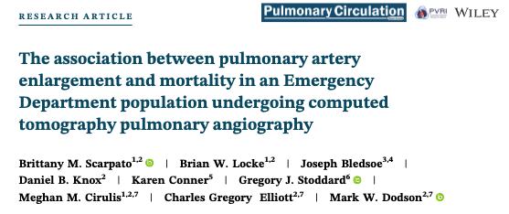
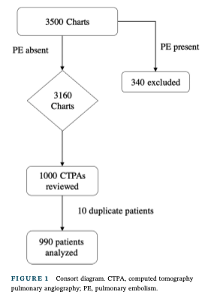
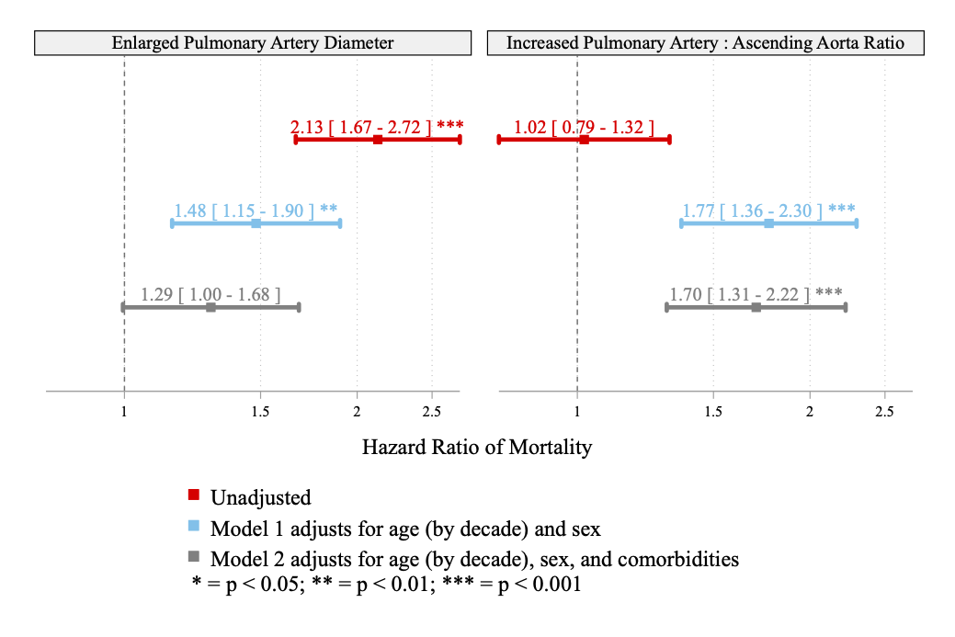

Does PA size predict mortality?
Does PA size add information beyond demographics?
Does PA size add information beyond what the ED might know?
 | PA diameter |  | PA:AA
 | Men | Women
Threshold | 29 mm | 27 mm | 0.9
Notes:
Conclusion finding from the original study:
Methods 990 anotated CT scans
classified as abnormal PAd or PA:AA
10y follow-up mortality
Increased mortality in both
Novelty: this relationship had been described in specific populations, but not the ED - which would be the logical take-off point for QI based referral systems aiming to identify.

Slide 4
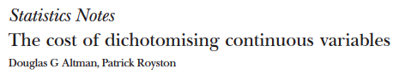
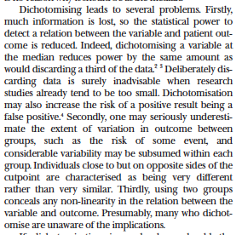
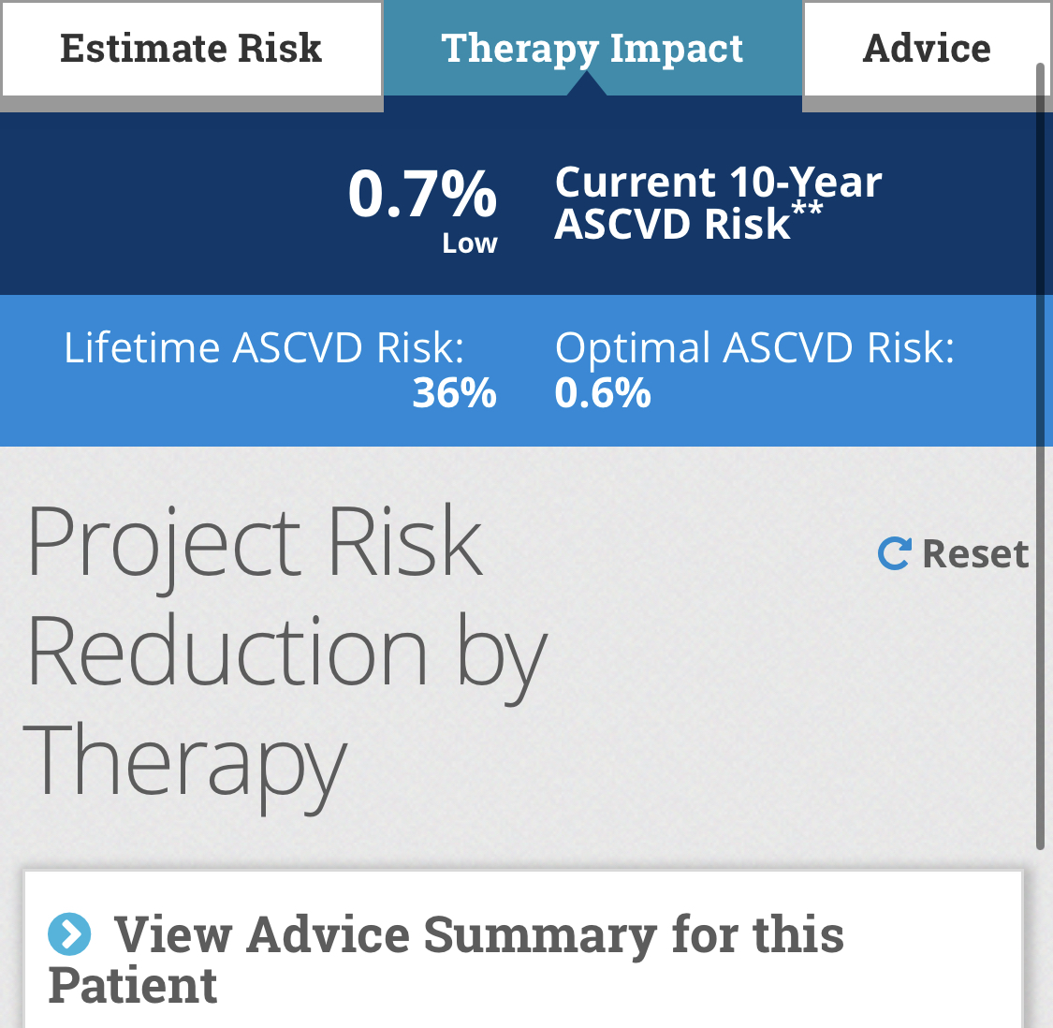
What makes a finding abnormal?
Old: It is uncommon to see values more extreme than this in healthy patients (classification)
 | PA diameter |  | PA:AA
 | Men | Women
Threshold | 29 mm | 27 mm | 0.9
New: Values more extreme than this identify someone at risk of having or developing a problem (prediction)
Ideal: Values more extreme than this identify someone who benefits from intervention (prediction)
Notes:
First law of statistical power: thou shalt not dichotomize a continuous variable ->
If you break things down by age & degree of elevation, there is a discordance
Dichotomizing/categorizing a continuous variable.

Slide 5
Unadjusted
Adjusted for Age + Sex

Slide 6
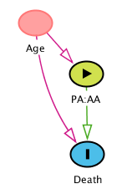
 | Total | Normal PA:AA (<0.9) | Increased PA:AA (0.9+)
 | N=990 | N=651 | N=339
Age (by decade)
<30 years | 15% (147) | 9% (58) | 26% (89)
30-40 years | 17% (165) | 14% (89) | 22% (76)
40-50 years | 17% (169) | 19% (121) | 14% (48)
50-60 years | 16% (159) | 18% (118) | 12% (41)
60-70 years | 15% (145) | 18% (114) | 9% (31)
70+ years | 21% (205) | 23% (151) | 16% (54)
Confounding can cause:
A spurious relationship
A spurious non-relationship
 | Total | Normal PAd | Enlarged PAd
 | N=990 | N=714 | N=276
Age (by decade)
<30 years | 15% (147) | 18% (128) | 7% (19)
30-40 years | 17% (165) | 19% (135) | 11% (30)
40-50 years | 17% (169) | 18% (126) | 16% (43)
50-60 years | 16% (159) | 16% (116) | 16% (43)
60-70 years | 15% (145) | 13% (96) | 18% (49)
70+ years | 21% (205) | 16% (113) | 33% (92)
Notes:
association isn’t causation… but also no association isn’t no causation
(ie. confounding can also be an explanation for a lack of association)
First law of statistical power: thou shalt not dichotomize a continuous variable ->
If you break things down by age & degree of elevation, there is a discordance
Dichotomizing/categorizing a continuous variable.

Slide 7
PA:AA
PAd

Slide 8
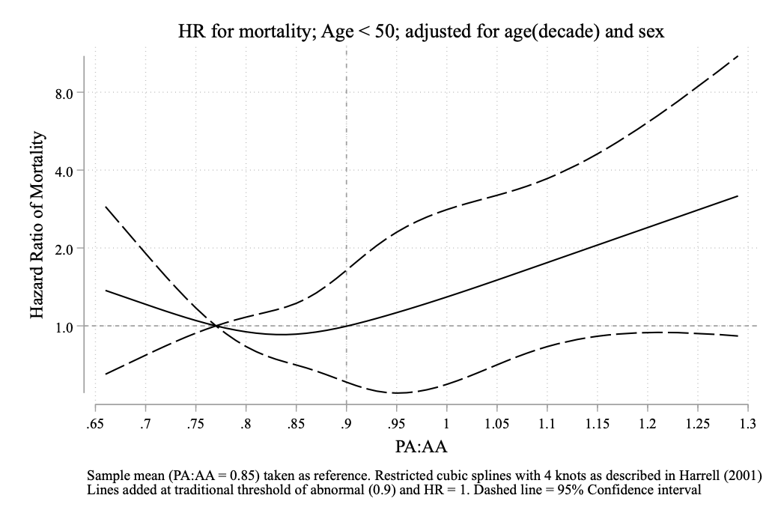
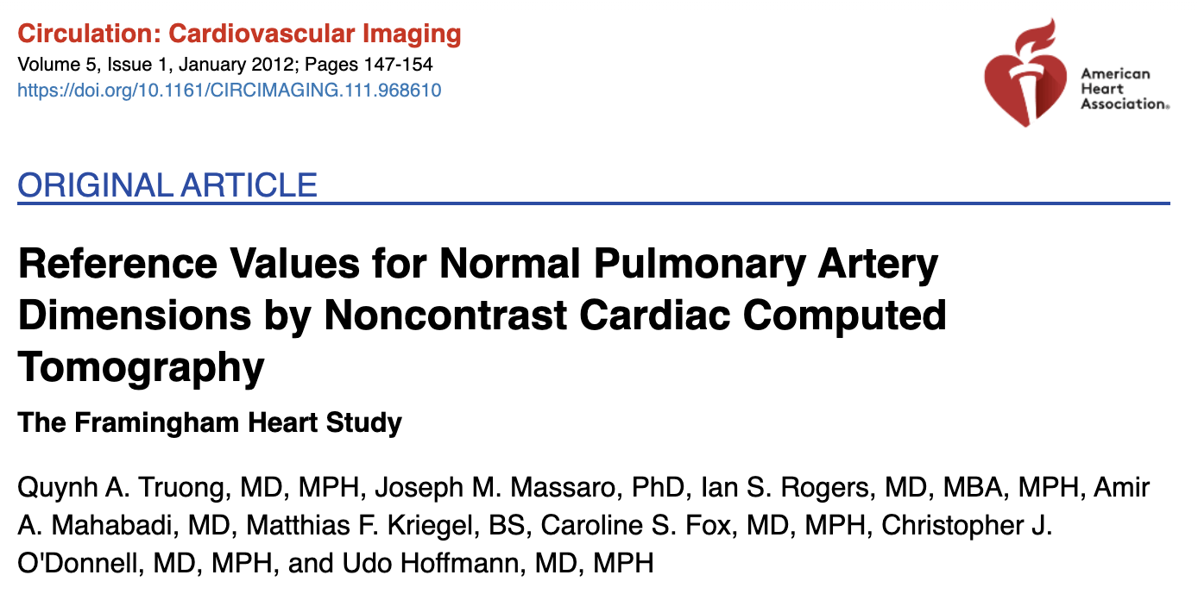
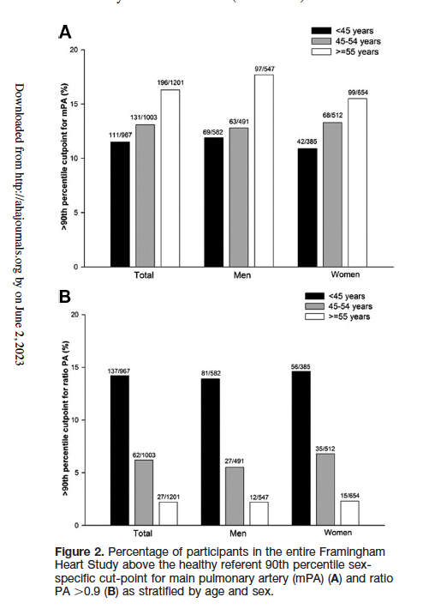
10 years of follow-up too short in young people?

Slide 9
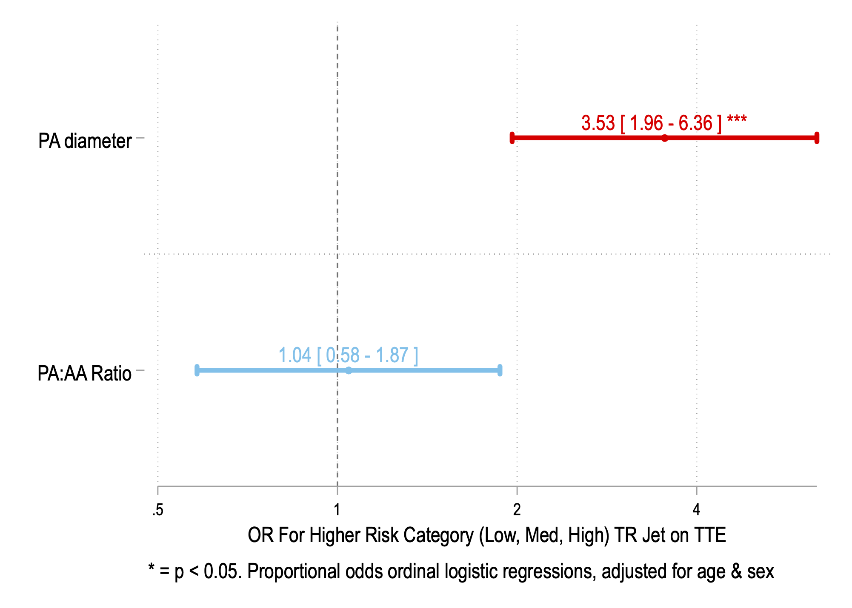
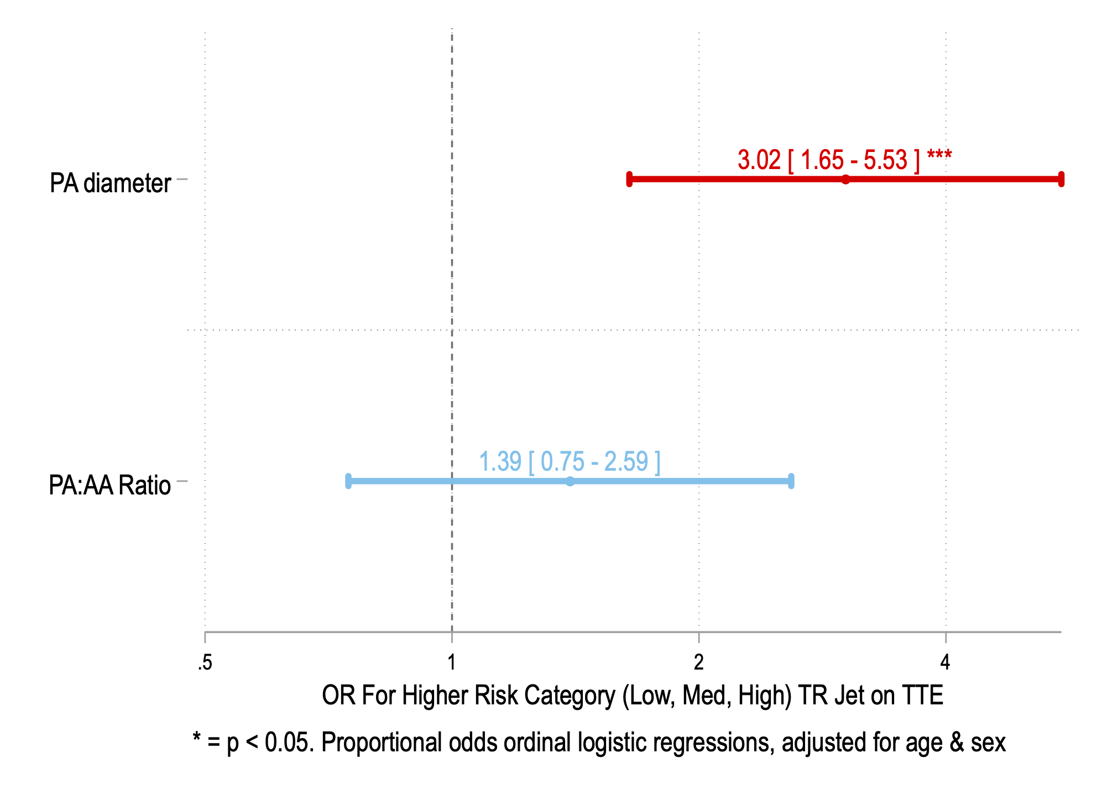
Conclusions
OR of TR Jet Vel. 2.8+ w/n 90d if PA enlarged
Unadjusted
When comparing people of the same age/sex, both PAd and PA:AA predict a higher mortality risk
PAd has a threshold; PA:AA is (log)linearly worse at higher ratio
PA:AA is strongly confounded by age → young people seem to have larger PA:AA without apparent excess risk when mildly elevated
Threshold for abnormal PA:AA should be higher in younger adults
(Yet) Unresolved Questions:
Is excess risk mediated by pulmonary vascular mechanisms?
Other outcomes besides death? (ER, Hospitalization) Who gets further workup and how do they do?
Can you use this information to target intervention? (e.g. PH referral)
Can data be combined for better prediction?
Adjusted: Age, Sex

Slide 10
 | Total | Normal AA | Enlarged AA
 | N=990 | N=732 | N=258
Age (by decade)
<30 years | 15% (147) | 19% (142) | 2% (5)
30-40 years | 17% (165) | 20% (149) | 6% (16)
40-50 years | 17% (169) | 19% (141) | 11% (28)
50-60 years | 16% (159) | 14% (103) | 22% (56)
60-70 years | 15% (145) | 12% (91) | 21% (54)
70+ years | 21% (205) | 14% (106) | 38% (99)
Notes:
Hidden slide on PA;AA confusion matrix

Slide 11
The Association of Weight Loss from Antiobesity Medications or Bariatric Surgery and Apnea-Hypopnea Index in Obstructive Sleep Apnea: A Systematic Review and Meta-Regression
Brian W. Locke M.D.; Ainhoa Gomez Lumbreras M.D., Ph.D.; Chia Jie Tan PhD.; Teerawat Nonthasawadsri PharmD; Sajesh Veettil MSPharm, PhD; Chanthawat Patikorn PharmD; Nathorn Chaiyakaunapruk PharmD, PhD
Under Review: JAMA NO

Slide 12
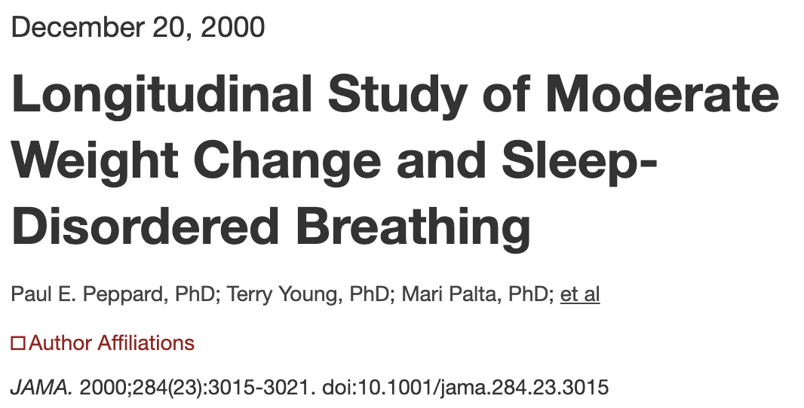
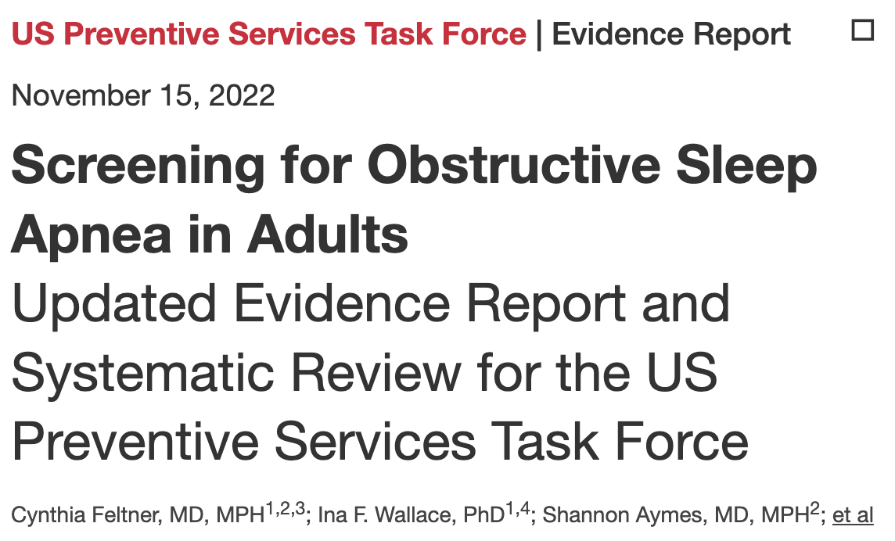
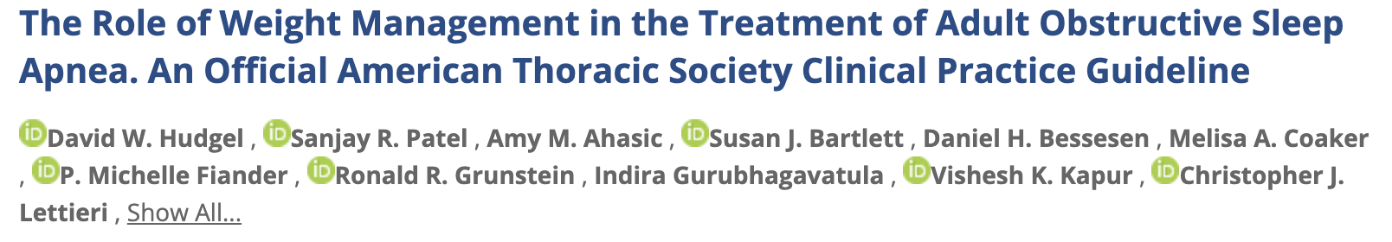
74 RCTs. PAP improves:
ESS
Sleep QOL
Overall HrQOL
There is not evidence PAP improves:
Mortality
MI/CVA events
Wisconsin sleep cohort
A 10% weight loss predicted a 26% (95% CI, 18%-34%) decrease in the AHI.
~70% w/ OSA are obese
5% (gen obese pop) lose >10%BW
Consider pharmacologic (BMI>27) and surgical (BMI>35) weight loss options & still overweight
Notes:
Intuition:
Rationale: ‘in the patient with ARDS depends on several factors: 1) the patient’s overall risk of death (4 words); 2) the extent to which risk of death is driven by ARDS versus other factors (disease-attributable risk); 3) the extent to which risk of death from ARDS is driven by the mechanism targeted by the intervention (mechanism-attributable risk); 4) efﬁcacy of the intervention to modify the mechanism attributable risk; and 5) risk of off-target effects from the intervention’
Talk about characteristics
Rationale: ‘in the patient with ARDS depends on several factors: 1) the patient’s overall risk of death (4 words); 2) the extent to which risk of death is driven by ARDS versus other factors (disease-attributable risk); 3) the extent to which risk of death from ARDS is driven by the mechanism targeted by the intervention (mechanism-attributable risk); 4) efﬁcacy of the intervention to modify the mechanism attributable risk; and 5) risk of off-target effects from the intervention’
Talk about characteristics

Slide 13

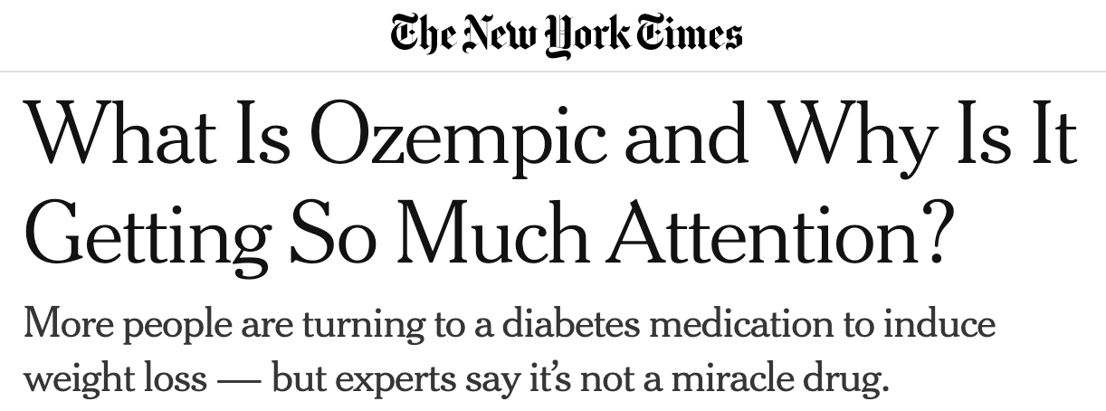

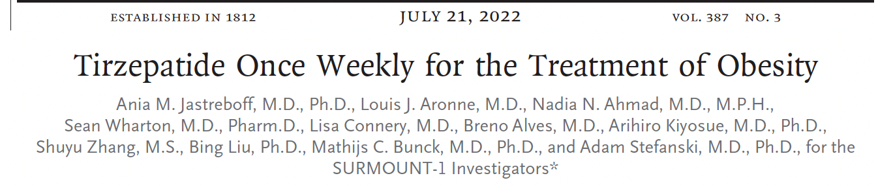
CMS National Coverage of Determination (NCD) – cannot pay for anti-obesity medications. (since 1993)
Heritability of obesity: 40-70%
Heritability of LDL levels: 22-91%
If LDL levels were visible and having low LDL were desirable/high-status, would we have the same restriction on statins?
 | Proportion >10% BWL | Mean %BWL
Gastric Bypass | 96-99% | 25-30%
Tirzepitide | 83.5% | 20.9%
Semaglutide | 69.3% | 10.8%
Prejudice→
Notes:
Rationale:
People don’t use CPAP
People are interested in these medications
Consider if LDL
-----
Obesity is tied up in value judgements
Being slim is high status, being obese is low status.
We think obesity is the result of life choices… but we are wrong.
Obesity is no more a result of personal choices than LDL or BP is; if we could see LDL, would we look down on those with hypercholesterol?
Energy balance 1lb gain
Prejudice: favoring a certain group on the basis of a characteristic that has no relevance to the judgement
Racism, Sexism, Speciesim, Weight discrimination?
Just as we’ve realized that “encouraging exercise and healthy eating” is not enough to prevent CVD (so we rx statins), it’s not enough for obesity (so we should treat obesity)
Obesity-related lung disease increasing in scope: treat it.
If there was sufficient data on OHS I would have studied that.

Slide 14
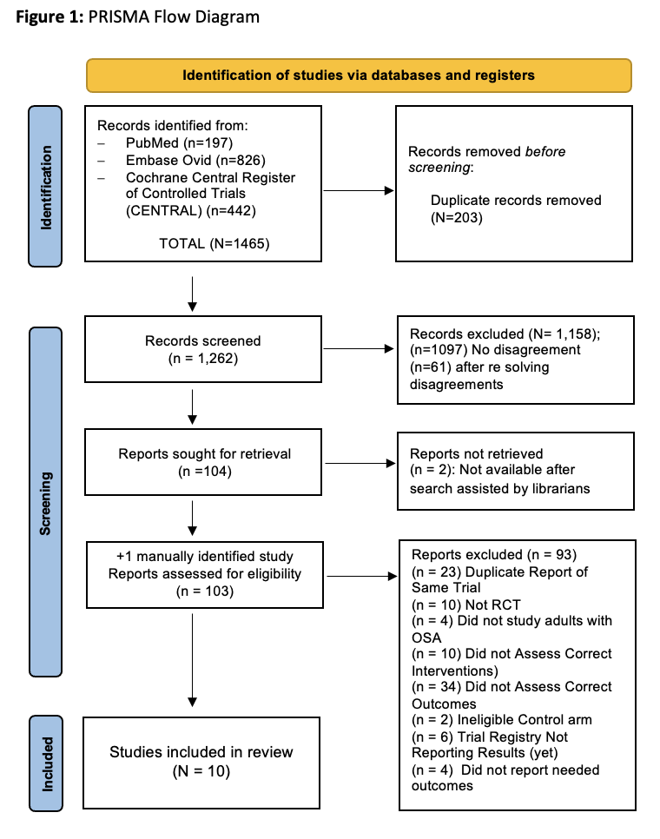
PubMed, Embase Ovid, and Cochrane Central
Design: RCTs, no blinding req.
Intervention: surgical or medical weight loss interventions
Comparator: placebo, no treatment, or standard of care.
Outcome: Must report percentage weight loss and AHI difference from randomization to one month or longer follow-up
Analysis: Meta-regression

Slide 15
1st Author | Year | Country | Centers | Intervention | N | Comparison | N | % Female by arm | Age by arm | Follow-up (mo) | Hypopnea Definition | Sleep Study | Overall risk of bias
Surgery
Bakker³² | 2017 | USA | 2 | LGB | 28 | CPAP | 21 | 43 : 43 | 50.7±9.2 : 46.3±10.5 | 18 | AASM 1999 | PSG | Some concerns
Dixon³⁵ | 2012 | Austrila | 7 | LAGB | 30 | Conventional Weight Loss Program | 30 | 43 : 40 | 47.4±8.8 : 50.0± 8.2 | 24 | Not specified, but required to be the same on reassessment | PSG | Some Concerns
Feigel-Gullier³⁴ | 2015 | France | 1 | LAGB | 33 | Intensive Nutritional Care | 33 | 47 : 25 | 46.9±8.6:50.1±7.4 | 36 | French Guidelines (as of 1999) | PSG | High Risk
Furlan³³ | 2021 | Brazil | 1 | Roux-en-Y Bypass | 24 | Usual Care | 13 | 92 : 69 | 40[36-49]:48[39-53] | 36 | AASM 2012 | HSAT | High Risk
Pharmacologic
Blackman³⁶ | 2016 | USA & Canada | 40 | Liraglutide 3 mg | 180 | Placebo | 179 | 28 : 28 | 48.6±9.9: 48.4±9.5 | 8 | AASM 2007 | PSG | Low Risk
Chen⁴¹ | 2020 | China | 1 | Exenatide | 22 | Insulin | 21 | 55 : 52 | 51.14±15.25 55.35±11.83 | 3 | Not Reported | PSG | Some concerns
Eskandari³⁷ | 2013 | Sweden | 1 | Zonisamide | 16 | Placebo | 16 | 0 : 13 | 55±10:53±14 | 1 | AASM 2007 | HSAT | Low Risk
ROMANCE^{38,42} | N/A | UK | 1 | Liraglutide 3 mg ±CPAP | 66 | Placebo ±CPAP | 66 | 58 : 52 | 54.5[45-61]:53.5[49-57] | 26 | AASM 2007 | HSAT | Some concerns
Tang³⁹ | 2019 | China | 2 | Dapagliflozin and Metformin | 18 | Glimepiride and Metformin | 18 | 45 : 35 | 56.1±7.2:57.9±10 | 6 | Chinese Medical Society | HSAT | Some Concerns
Winslow⁴⁰ | 2010 | USA | 1 | Phentermine-ER/Topiramate | 22 | Placebo | 23 | 59 : 35 | 53.4±7.0:51.4±5.7 | 7 | Not Reported | PSG | Low Risk
Notes:
10 RCTs enrolling (n = 843) patients were eligible for inclusion (Figure 1). Studies that initially appeared to meet the inclusion criteria but were excluded are described in Supplementary Material S4. Of the included studies, 4 (n=200) evaluated surgical interventions³²⁻³⁵ and 6 (n=643) investigated AOMs.³⁶⁻⁴² Median follow-up time was 13 months (interquartile range(IQR) 6 to 26 months).

Slide 16
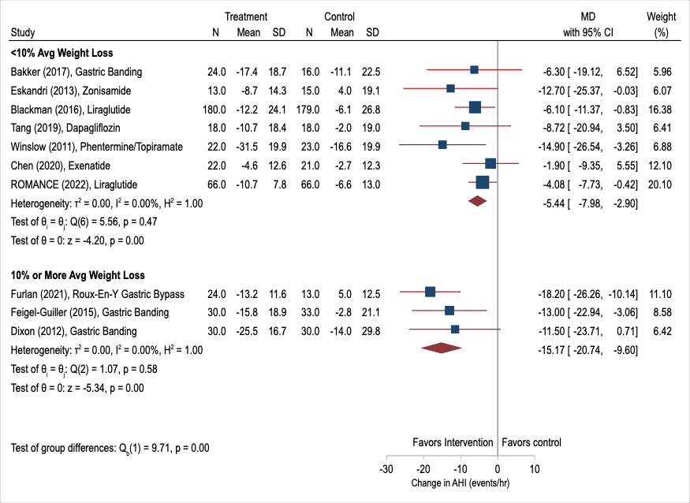
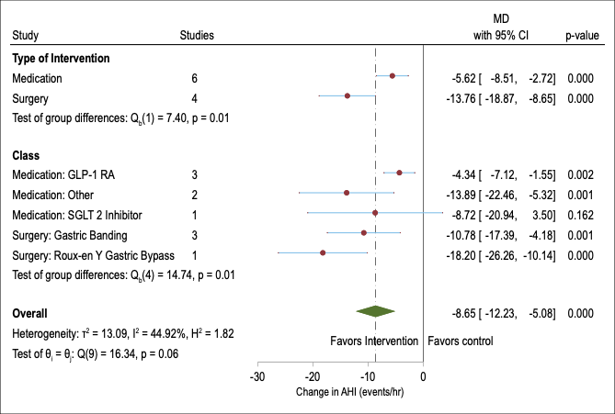
10 eligible trials (n=843 patients) were included. Four (n=200) assessed bariatric surgery and 6 (n=643) assessed pharmacologic interventions over a median follow-up of 13 months (interquartile range 6 to 26 months).

Slide 17
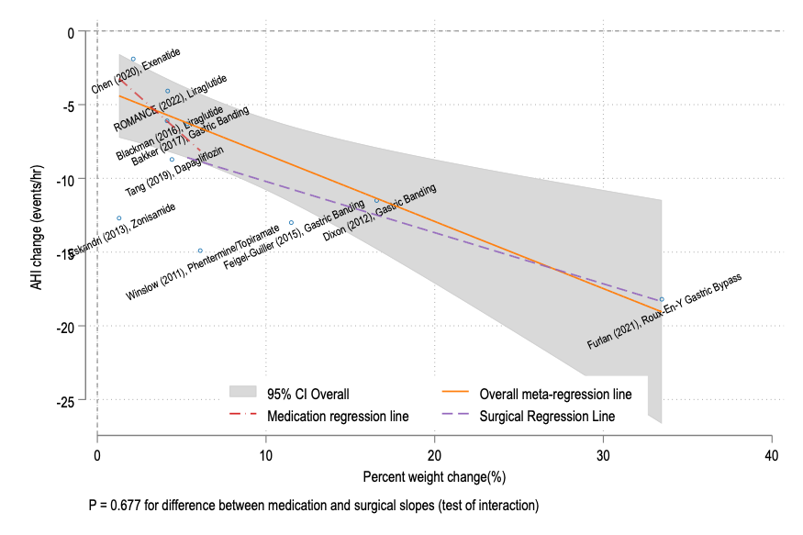
Decrease of 0.45 (95% CI: 0.18-0.73 events/hour) events per hour for each 1% body weight loss
Corresponds to a 1.84% AHI change (95% CI: 0.34-3.33%)

Slide 18
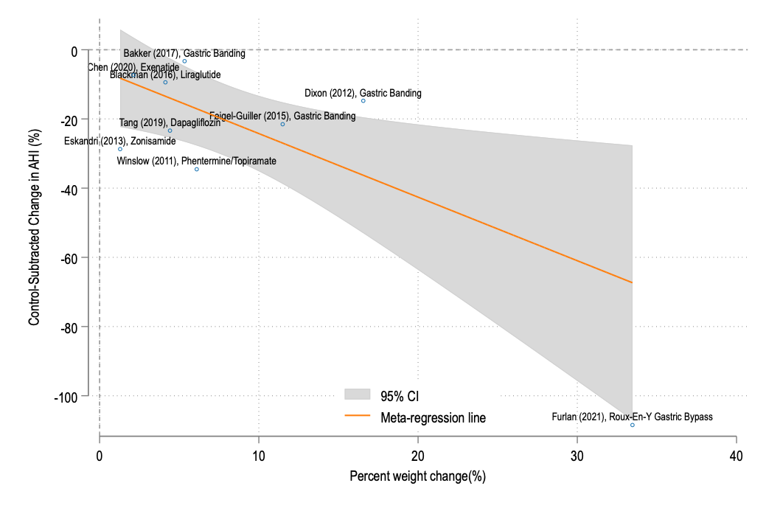
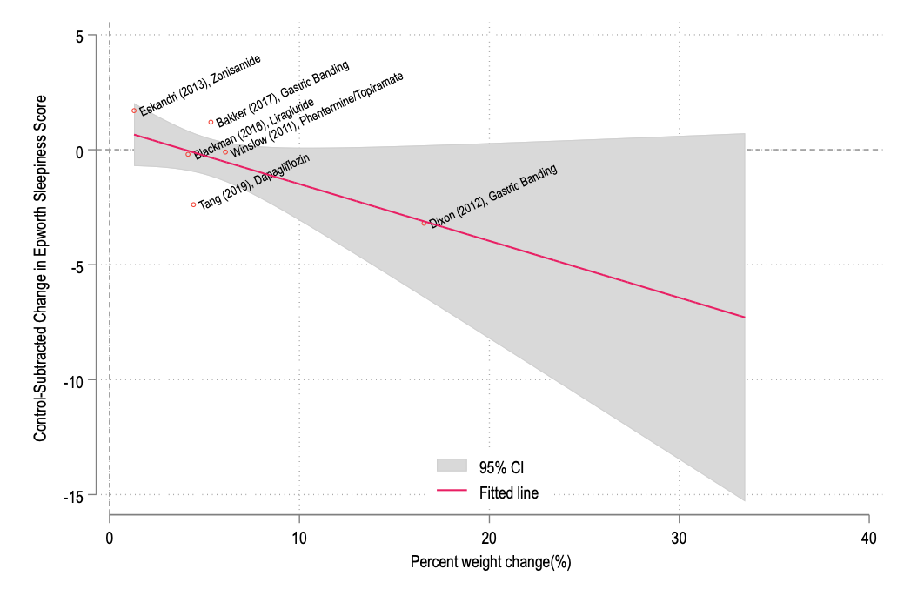
%Change in AHI
Change in ESS

Slide 19
Conclusions
Novelty: can predict how much AHI improvement to expect from anti-obesity interventions
Prior observational data: subject to confounding by the cause of weight loss
This data: still subject to study-level confounders (selection into study; distribution of endotypes)
Intervention | Estimated Weight Loss | Source | Expected Improvement: AHI (events/hr) | Expected Improvement: AHI (%)
Vertical sleeve gastrectomy | 25% | Heymsfield and Wadden 2017 NEJM Review²² | AHI -15.2 (95 CI -9.80 to -20.61 events/hr) | 51.8% improvement [24.1 – 79.5%]
Tirzepatide | 20.9% | SURPASS Trial²³ | AHI -13.3 events/hr [-8.9 to -17.7] | 44.3% improvement [22.0 – 66.4%]
Semaglutide | 10.8% | AGA 2022 guideline²⁴ | -8.74 events/hr (95 CI -6.22 to -11.2 events/hr) | 25.7% improvement [14.4 – 37.0%]
Could inform practice / policy.
More robustly: could inform trial design.
Surmount-OSA (Eli Lilly): 90% power for 50% AHI reduction. ETA 1 year.
Notes:
Tirzepatide
20.9%
SURPASS Trial²³
AHI -13.3 events/hr [-8.9 to -17.7]
44.3% improvement [22.0 – 66.4%]
Semaglutide
10.8%
AGA 2022 guideline²⁴
-8.74 events/hr (95 CI -6.22 to -11.2 events/hr)
25.7% improvement [14.4 – 37.0%]

Slide 20
Predictors of Initial CPAP Prescription and Subsequent Course in Patients with Central Sleep Apneas.
Brian W. Locke MD, Jeffrey Sellman MD, Jonathan McFarland DO, Francisco Uribe MD, Kimberly Workman RPSGT,
Krishna M. Sundar, MD

Slide 21
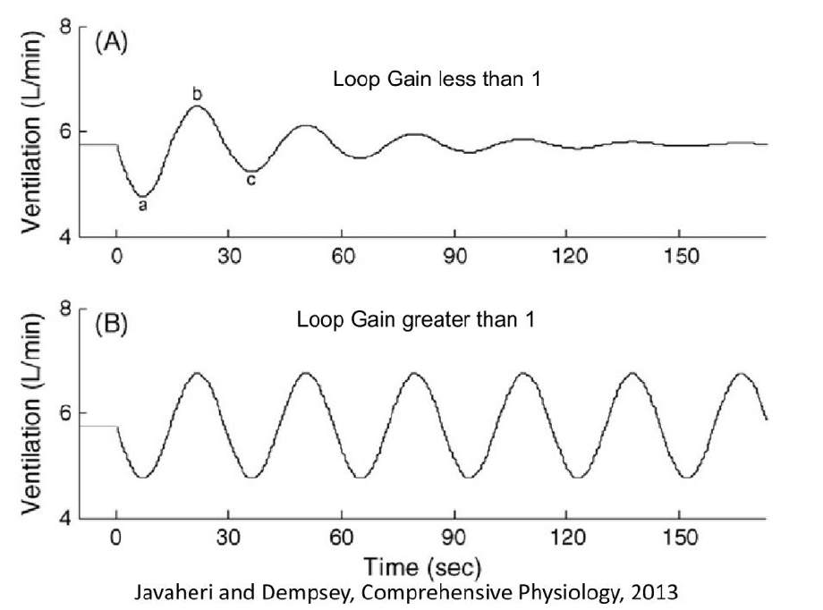
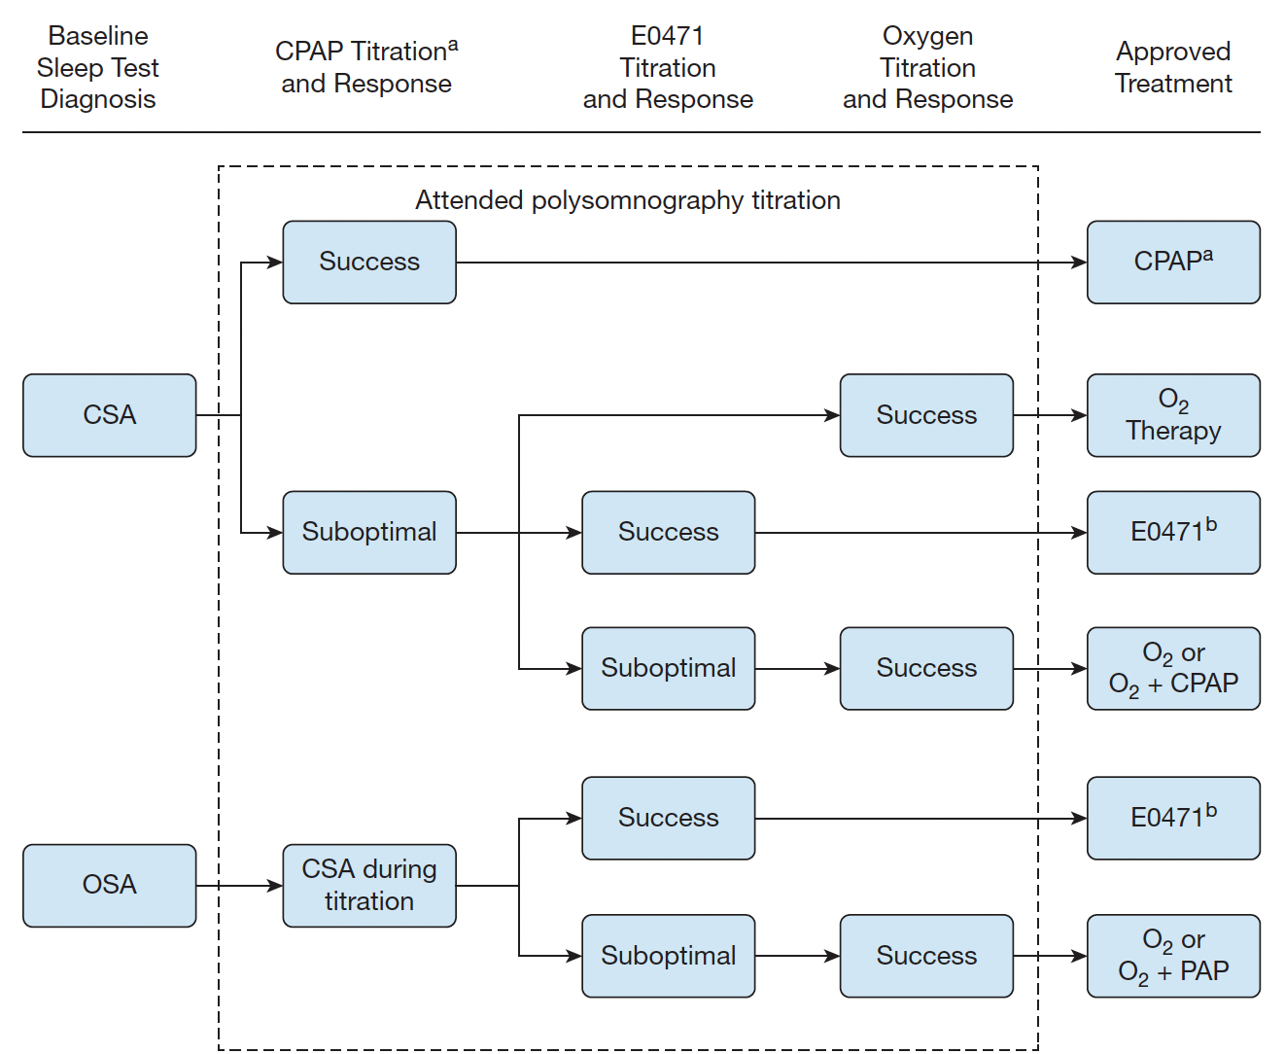
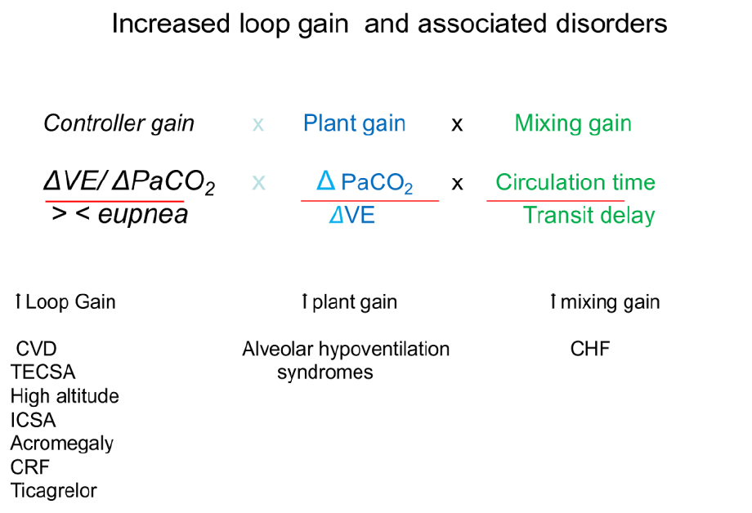
Causes of Central Sleep Apnea
High loop gain from high controller gain | High loop gain from high plant gain | Failure of rhythm generation
Individual Events:
Proportion of Events:
Pure
Central
Pure Obstructive
CPAP often lowers controller gain: addressing (intermittent) hypoxemia
CPAP often lowers plant gain: improving hypercapnia
Notes:
Loop gain: as a measure of ventilatory stability and susceptibility to central apnea and recurrent breathing instability.
Controller gain: how sensitive is the respiratory system to changes in PaCO2 or PaO2?
Plant Gain: how much does CO2 change when the brainstem alters ventilation

Slide 22
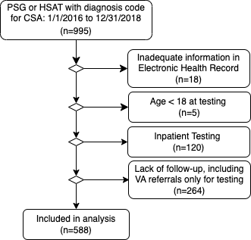
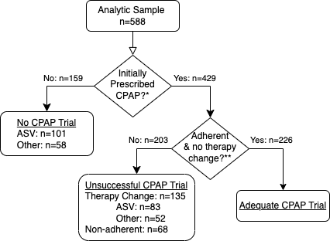
Modeled clinicians implied prediction (independent predictors of decision to prescribe CPAP)
Modeled independent predictors of outcomes
Research Question: do clinicians accurately predict who will respond favorably to a trial of CPAP?
Operationalization: are predictors of receiving (or not receiving) a trial of CPAP also the predictors of failing a trial of CPAP when it is tried?

Slide 24
Rational decision-making when you can’t predict perfectly:
 | Outcome → | CPAP adequate if trialed | CPAP not adequate if trialed
Prediction ↓
CPAP trialed |  | True Positive | False Positive
CPAP not trialed |  | False Negative | True Negative
??
Harms of the two types of errors
“False Positive “ (trialed CPAP, didn’t work) | “False Negative” (didn’t trial CPAP, would have worked)
Delayed effective treatment Patients less likely to adhere to PAP if it has previously failed them | More expensive Requires more expertise May be harmful in some settings (SERVE-HF)
Optimal “threshold” (minimum predicted probability of CPAP failing where it Is still worthwhile to try) depends on how bad False Positive is relative to False negative. Is it plausible that the optimal threshold varies by characteristics? Yes, for some…
Notes:
The key advance involves the concept of threshold probability (p_{t}): the minimum predicted probability of an event at which a decision-maker, such as a doctor or patient, would opt for an intervention
Defining the tradeoff of harms associated with each type of error (i.e. how many patients are we willing to subject to an unsuccessful CPAP trial in order to prevent one patient who would have done well on CPAP being treated with ASV?) is required to determine the optimal rate of trialing CPAP. While this exchange rate will require prospective trials to determine and may vary by situation, it is unlikely to vary across the strata of covariates examined (e.g. why would there be a difference in the relative harms by age or smoking status?). Therefore, the observed disordances likely represent suboptimal predictions of benefit by the prescribing physicians.
Therefore: if you submit that clinicians are unlikely to be accurate predictors of who will respond.
Additionally, because people who receive a more complicated mode are not frequently “de-escalated”, clinicians are very likely to systematically under-appreciate how many false negatives they may have with their current prescription strategy.
This would manifest as a general bias of the blue bars to the right – which is what we see, although not uniformly so.
(This could also be explained if providers believed that it is more important to avoid unsuccessful CPAP trials than to avoid excess ASV treatment.

Slide 25
Other findings:
 | Total | Diagnosed by PSG | Diagnosed by HSAT | p-value
 | N=588 | N=426 | N=162
…
Neurologic Causes | 19% (114) | 21% (89) | 15% (25) | 0.13
Cardiac Causes | 27% (158) | 27% (113) | 28% (45) | 0.76
Medication Etiology | 11% (67) | 14% (58) | 6% (9) | 0.006
Primary CSA | 1.5% (9) | 1.2% (5) | 2.5% (4) | 0.25
Treatment-Emergent | 35% (207) | 37% (157) | 31% (50) | 0.17
OSA-Associated Centrals | 14% (82) | 10% (43) | 24% (39) | <0.001
…
Results |  |  |  | <0.001
No CPAP Rx | 27% (159) | 31% (133) | 16% (26)
Rx CPAP, Adequate | 38% (226) | 34% (145) | 50% (81)
Rx CPAP, Inadequate | 35% (203) | 35% (148) | 34% (55)
Inverse-probability of CPAP weighting adjustment leads to no major change (* more on this later)
However, if patients who received CPAP are different in unmeasured characteristics (HCSR, etc.) then groups aren’t validly comparable.

Slide 26
Conclusions:
Providers decisions about whether to trial CPAP appear to correctly weight some features (e.g. Opiates, % CSA) but incorrectly weight others (Age, OSA-associated centrals)
Optimal rates of CPAP trial are TBD, but nudges might offer improvements.
Outcome assumes providers/patients continue therapy benefiting them…
When HSAT (unexpectedly) identifies CSA, CPAP is often trialed and often effective)
Baclofen- or Opiate-related centrals respond poorly to treatment, even when they constitute <50% events
Perhaps should be considered CSA, even when not meeting dx criteria
Notes:
The modern taxonomy of Central Sleep Apnea (CSA) recognizes at least two mechanisms leading to central apneas or hypopneas (collectively termed ‘central events’): ventilatory control instability and failure of rhythm generation.³
CPAP (as well as oxygen) may improve ventilatory control stability

Slide 27
Computable Phenotypes for Identifying Hypercapnic Respiratory Failure
Brian W Locke MD, Wayne Richards MSc, Jeanette K Brown MD PhD, Ramkiran Gouripeddi MBBS MSc, Krishna M Sundar MD
Problems with retrospective EHR-based research: Missing Data, Time/Event determination (immortal time), Observational nature (residual confounding; multiple comparisons), Disease Identification (enrollment, covariates, outcomes)
Contrast: Prospective cohort with systematic assessment and verification of diagnostic labels… (Asthma, COPD, OHS, OSA)
Computable phenotype: an algorithms to identify specific types of patients
Simple: e.g. inclusion criteria to a study
Complex: use additional data elements (demographics, meds), natural-language processing, etc.

Slide 28
Why not just include patients w PaCO2 > 45? (or an ICD code for hypercapnic respiratory failure?)
Study Aim | Efficacy Trial | Determine Burden of Disease | Improve Processes of Care
Ideal Characteristic | Select a population with severe disease, homogeneous in characteristic that predicts treatment responsiveness | Capture all patients who suffer from the adverse consequences of hypercapnic respiratory failure | Identify all patients who will benefit from instituting certain management pathways
Example | Severe COPD, no other cause of CO2, severe air trapping, PaCO2 > 52 mmHg | More sensitive definition? (If only use PaCO2, you will miss patients and skew toward people with classic/severe presentation)
ABGs are variably obtained in clinical practice: less reliable in usual care than enrollment criteria
People who get ABGs are different from people who don’t
Practice varies widely by setting
Symptoms are variable, the diagnosis is missed in the majority of cases
(Nowbar 2004; Nowalk 2023 SLEEP Abstract)
What is the national re-admission rate?
How common are admission with hypercapnia?*
Does PM 2.5 influence?
Notes:
What is the consequence of only assessing “recognized hypercapnia” is that
It’s not a stable construct between places with different patterns
It does not select a representative set of patients with the physiology of interest
Why could this help in Hypercapnic Respiratory Failure?
Pretest probability varies widely -> thus strength of evidence ought to vary if attempting to achieve constant credibility
The symptoms are variable, and the diagnosis is frequently missed.
Blood gasses hurt to obtain, not commonly obtained unless clinicians suspect diagnosis. Propensity to obtain ABG varies widely by provider, setting, and patient
TODO: figure to represent distribution of comorbidities?
or, in critical care – you include everyone and the trials are negative.. But that’s a separate issue
Better operational defintions:
How common is hypercapnic respiratory failure?
Inability to estimate burden - is it increasing?
What should patients with hypercapnic respiratory failure expect?
Unable to identify and prioritize treatment needs – who do we know how to treat? Who should we figure out how to treat?
Criteria for a good definition:
Reliable (identifies only & all) –
Bayes: P(Pre-test) ↑ : Required strength of evidence ↓ for same P(Post-test)
Feasible (usual data elements) – ABGs frequently not obtained; HCVR, MVV...
Valid (truly measures what we’re interested in)
Possible to have PaCO2 < 45 and not meet bodies demand (e.g. metabolic acidosis)
Possible to have ‘hypercapnic success’ (e.g. metabolic alkalosis, submissive hypercapnia)
People who have high risk of future/ongoing death, readmission, or activity limitation from ventilatory insufficiency have the criteria. People with low risk do not.
“Although here we focus on the use within a research context, phenotype definitions support a wide variety of purposes beyond research, including quality improvement, clinical decision support, population health management, and public health”
[x] https://onlinelibrary.wiley.com/doi/10.1111/resp.14413 editorial on hypercap epidemiology.. highlights need for better methods than ABG to identify. This can be a key citation.
“Tertiary prevention refers to the action taken to reduce the chronic effects of a health problem in an individual or a population by minimizing the functional impairment consequent to the acute or chronic health problem”

Slide 29
Needs: initial decompensation → treatment
Presentation With Hypercapnia
Hypercapnia is common, highly morbid, and likely increasing in frequency (obesity, opiates, multimorbidity)
Correctly Recognized?
Inpt Hypercapnia is frequently missed in practice
Marik, JICM 2012: 75% miss rate.
Nowbar, AJM 2004
Causes Correctly Diagnosed?
Many patients do not receive definitive testing
OSA in 5-15% vs 50-80%
Is there data to guide treatment?
We don’t know what to do for many (most?) patients with hypercapnia
No good estimate? (NMD/Rest, COPD, OHS, OVS)
Is it logistically possible?
Device qualification restrictions.
No good estimate?
Does it happen?
Requires coordination between Inpt → Outpt. Consider CHF (CMS f/u after discharge)
No good estimate?
Notes:
Patients prone to ventilatory decompensation are not currently systematically identified or managed, and so frequently fall through the cracks. Identification and treatment of sleep disordered breathing and its risk factors is a promising approach to improve care but requires empiric support to justify implementation.
Motivation for the research Dash systematized, identification, and assessment, with a battery of a valuations is likely to lead to a large improvement in readmission. Include this as the reason to do this research. It’s needed because this is common and commonly missed and highly morbid.
[x] https://onlinelibrary.wiley.com/doi/10.1111/resp.14413 editorial on hypercap epidemiology.. highlights need for better methods than ABG to identify. This can be a key citation.
“Tertiary prevention refers to the action taken to reduce the chronic effects of a health problem in an individual or a population by minimizing the functional impairment consequent to the acute or chronic health problem”
My vision: someone comes in with hypercapnia - they are identified as someone who for some reason has frailty of their ventilatory control or performance and thus at high risk of future adverse outcomes. This triggers a number of assessments to identify the causes for this frailty, and triggers a pipeline for respiratory care (both diagnostic studies and outpatient treatment.
Current reality: referral to sleep medicine in placed. They receive steroids, antibiotics, diuretics and slowly improve. They are sent home on oxygen and bounce back.
Why are we doing it?
Prevalence if hypercapnia is likely rising: Obesity, Opiates, Multi-morbidity
What are the most common component causes? Not known
Existing evidence pertains to well-defined populations that do not reflect clinical practice
No consensus exists around how to systematically identify, nor manage these patients after stabilization.
HUGE room for improvement in processes of care, but evidence is required.

Slide 30
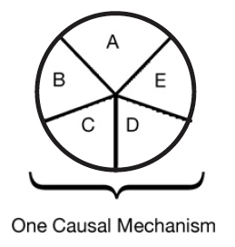
Proposed framework: Sufficient vs Component Causes (Rubin)
Hypothetical patient with hypercapnic respiratory failure
Sufficient cause: a set of factors that will cause disease when present
End-stage COPD with hyperinflation
Component cause: a factor that, if not present, no disease would occur
Untreated OSA, metabolic alkalosis, chronic opiate use
COPD
Obesity
Loop diuretic
Untreated
Sleep Apnea
Opiates
Notes:
Necessary cause: in all sufficient sets, this component must be present
“Perhaps the most important of these principles is self-evident from the model: A given disease can be caused by more than one causal mechanism, and every causal mechanism involves the joint action of a multitude of component causes”’
“The importance of multicausality is that most identified causes are neither necessary nor sufficient to produce disease. Nevertheless, a cause need not be either necessary or sufficient for its removal to result in disease
prevention. If a component cause that is neither necessary nor sufficient is blocked, a substantial amount of disease may be prevented."
Rothman and Greenland

Slide 31

COPD
Trial Data
+Guidelines
Wait 2-4 wks
Overlap Sydnrome
Observational Data
???
Undifferentiated
No tx data
Limited epi data
OHS
Observational Data
+Guideline
Start Immediately
COPD, Very Severe
COPD, mod severe
AHI 50 events/hr
COPD, mod severe
AHI 10 events/hr
Met. Alk loop diur
BMI 45 kg/m2
AHI 50 event/hr
PaCO2 52 mmHg
PaCO2 50 mmHg
PaCO2 50 mmHg
PaCO2 50 mmHg
Swap any combination of:
Muscular weakness
Obesity
Opiate use
Lung disease
Etc.
Post-Admission for Hypercapnic Respiratory Failure Management
Notes:
Not safe to generalize

Slide 32

Mini-Systematic Review: (Reviewed in singlicate)
EMBASE search for human cohort studies: “hypercapnic respiratory failure” “hypercarbic respiratory failure” “hypoventilation” “respiratory acidosis” and all EMTREE subtypes.
AS Review – AI-assisted systematic review
9455 → 10 studies evaluating prevalence, comorbidity profile, post-discharge prognosis discharge of patients with hypercapnic respiratory failure
van de Schoot, R. et al. An open source machine learning framework for efficient and transparent systematic reviews.
Nat Mach Intell
DOI:10.1038/s42256-020-00287-7
Study | Definition Used | Aim
Meservey et al 2020. USA (Vermont) DOI: 10.1007/s00408-019-00300-w | 18 y/o+ admitted (either ICU or floor) with diagnostic code for hypercapnic respiratory failure | What features of patients admitted for hypercapnic respiratory failure predict readmission?
Chung et al, AUS, 2021 DOI: DOI: 10.1164/rccm.202108-1912LE | Identified by initial ABG PaCO2 over 45, excluded iatrogenic causes/sedation. | What is the population prevalence of hypercapnia from any cause? Also, subsequent publication evaluating comorbidity prevalence.
Vonderbank et al 2020. Germany DOI: 10.2147%2FOAEM.S242075 | All patients with dyspnea or pulm disease admitted to hospital received capillary blood gas (some screening with VBG) ; PaCO2 45 mmHg. | Is hypercapnia predictive of mortality at a specialty hospital?

Slide 33
Prevalence of OSA
Study | Definition Used | Aim
Thille et al 2018 France DOI: 10.1007/s00134-017-4998-3 | ICU; pH<7.35 & PaCO2 45+; treated with NIV or IMV; survivors | What is the prevalence of undiagnosed OSA among survivors of Hypercapnic RF?
Ouanes-Besbes et al. 2021, Tunisia PubMed: 33171053 | Admitted to ICU 2015-2018, PaCO2 > 45mmHg, pH < 7.35. No prior OSA syndrome diagnosis. | What is the prevalence of undiagnosed OSA among survivors of Hypercapnic RF?
Adler et al. 2017, Switzerland DOI: 10.1164/rccm.201608-1666OC | Recruited at ICU discharge after surviving: primary admission for Resp failure, PaCO2 > 47.5 mmHg and requiring NIV or IMV | What is the prevalence of comorbidities, including OSA, among survivors of Hypercapnic RF?

Slide 34
Evaluation of Subgroup by Compensation Status
Study | Definition Used | Aim
Compensated Hypercapnia
Wilson et al., 2021. USA (Michigan) PubMed: 33951397 | 18+, hospitalized w/ ABG showing CO2 over 45 and pH 7.35-7.45 | Prognostic Significance of Compensated Hypercapnia
Bulbul et al. 2014. Turkey. doi: 10.4103/1817-1737.128851 | Hospitalized adults with PaCO2 over 45, no acidosis, and breathing room air | What comorbidities occur with inpatient, compensated hypoventilation
Marik 2016. USA (Virginia) DOI: 10.1002/osp4.27 | Age 18-90; BMI ≥ 40 kg m²; daytime PaCO2 > 45 mmHg, admission HCO3 > 28 mEq L⁻¹. Excluded: intrinsic lung disease; thoracic MSK/NMD; 20+ pack year smoking, COPD | What is the prevalence of undiagnosed Obesity Hypoventilation among hospitalized adults?
Respiratory Acidosis
Cavalot et al 2021, Toronto DOI: 10.1080/15412555.2021.1990240 | ABG with pH < 7.35 and PaCO2 > 45 mmHg OR VBG pH 7.34 and PvVO2 > 50 mmHg & presence of respiratory symptoms (CEDIS codes). Exclude CF, NM dz, ILD, thoracic dz, lung ca, CNS dz, Overdose, or trach | 1 year re-admission rate for patients presenting with acute respiratory acidosis

Slide 35
Methods: Data source
De-identified, patient-level data (not PHI, though recommended to be treated as such)
Federated data from medical center EHRs
80 Healthcare Organizations; mostly (but not exclusively) AMCs
80+ gb of data.
1.2 Billion ‘facts’ in medications alone.
Center for High Performance Computing protected environment
Data Available | Data unavailable
Demographics Diagnosis Medications Procedures Labs Cancer registry (NAACCR) Allergies Death Records* (in progress) | Some notes* Diagnostic reports DICOM image objects Providers Departments/clinics
Notes:
[ ] add what big data gets you?

Slide 36
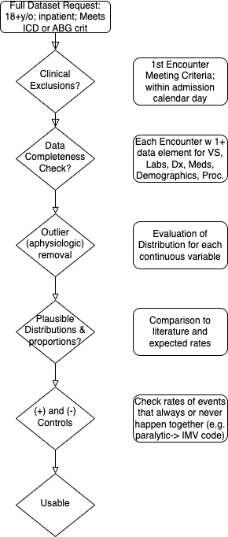
Methods: Data Processing
Problem for our study
Mechanisms of Data Incompleteness:
E.g. Diagnoses
For a given encounter, the institution must have submitted some data (any data) for each of the data elements requested.
Data validation measures:
Positive controls: e.g if dx of Pna, expect abx Rx
Negative controls: <BMI 30 in OHS
True (patho)physiologic state
What the clinician recognizes
What the clinician documents
What information is structured
What data is aggregated in TriNetX
Missing data here is part of what we want to study
Notes:
Perhaps go through and give metrics for how much the original data varied from this: https://www-ncbi-nlm-nih-gov.ezproxy.lib.utah.edu/pmc/articles/PMC5051581/ ←- different categories/metrics of data quality
BMI: 10-100 - BMI is truncated at 50 to avoid identifying notable patients.
RR: 2-75 --- // whats going on with respiratory rates below 4? - do we think these are coding errors or peri-arrest? — seems like they are preferentially in the ventilation procedure code group… perhaps this is an error in how IMV vs spontaneous breaths are coded in the dataset? I think nothing to do here yet.
Temp(F): 30 - 110
Sys BP: 30 - 350
Dia BP: (15 on revamp) 20 - 250
SpO2: 50-100
HR: 15 - 300
Temp: outside 70F - 110F; 20c - 43c
*** If temperature is between 20-43, can be assumed to represent C and converted to Fahrenheit
Example methods discussion from supplement here: https://www.ncbi.nlm.nih.gov/pmc/articles/PMC8404019/)
“Step I. Data preprocessing
To ensure data quality and hypothesis of clustering algorithm was satisfied, the following preprocessing steps were performed:
(1) data cleaning
Data cleaning was performed on vital monitoring and lab result data to filter out erroneous measurement and correct unsuccessful default data conversion. We examined the statistics and distribution plot of selected clinical variables and FiO2 which were used in calculation of PaO2/FiO2 ratio (P/F ratio). Erroneous measurement such as pH < 6 were removed from the dataset. Additional data conversion was performed on entries where the default data conversion is unsuccessful. For example, bicarbonate measure recorded as “>45” was converted to 45 and age recorded as “>89” was converted to 89. For calculation of P/F ratio, if multiple arterial blood gas test (ABG test) results were recorded at same timestamp with different FiO2 settings, P/F ratio were marked as missing value since we were unable to map PaO2 measurements to corresponding FiO2 ventilator settings.
(2) distribution transformation
We examined skewness and distribution plot of selected variables and applied log transformation on variables with long trails (e.g. Blood Urea Nitrogen, Creatinine).
(3) extreme value bounding
Due to clustering algorithms are sensitive to outliers, we bounded all measurements to their 0.02 and 0.98 percentile respectively to eliminate erroneous and extreme values.
(4) normalization
Normalization was performed for each variable. Categorical variables are encoded by 0 and 1.
(5) removing observations with missing variables
Large number of missing values indicate high degree of information loss. To ensure observations in eICU derivation cohort contains adequate information for clustering, all patients with 10 or more missing variables were removed.
(6) missing value imputation
We observed missing values in eICU dataset under different variable extraction window.¹ Due to clustering algorithm did not accept missing value as input, data imputation is required. We assumed: variables are missing at random (MAR). Multiple imputation by chained equations (MICE) was applied to the dataset and all clinical variables were modeled by linear regression.^{2,3} MICE generated 10 independent datasets in the imputation procedure. For visualization, the last imputed dataset was selected to generate plots. For modelling, standard clustering was performed on each of the imputed datasets, and their parameters were pooled to obtain the final model.
(7) correlation analysis
Correlation matrix of selected clinical variables was analyzed.
Step II. Understanding the clustering structure
Data points can group in non-overlapping balls with clear boundaries in between or group in one ball that can be partitioned into multiple subgroup in high dimensional space. To understand the grouping structure of points, we applied a clustering algorithm called ordering points to identify the clustering structure (OPTICS).⁴ OPTICS is a density-based model which can detect clusters in various densities. A reachability plot was produced with OPTICS, which was used to determine if data points are group in non-overlapping balls. If the reachability plot consists multiple segmented curves with points on the tail of one curve significantly higher than most points on another curve, points in the underlying dataset are likely group in non-overlapping balls. If the reachability plot consists one smooth curve, points in the underlying dataset are likely to group in one ball. The reachability plot for both eICU derivation and validation cohort were smooth curves, indicating that points were grouped in one ball and that partition clustering model was preferred.
Step III. Clustering
We used centroid based K-means clustering (K-Means) as the clustering model in this study. To determine the optimal number of cluster k, we examined the Gap statistics and the Gap* statistics. Consensus clustering (CC) is used the cross validation the cluster assignment of K-Means.
To evaluate the clustering result, we considered both theoretical and practical factors including: (1) Goodness of fit (2) Adequate large cluster size (3) Salient difference in clinical characteristics between different phenotypes. Phenotypes were visualized by: (1) t-distributed stochastic neighbor embedding plots (t-SNE)⁵ (2) Line plot of variables normalized by 3 phenotype population mean (3) Rank plot of variables normalized by 2 phenotype population mean.
The optimal number of cluster k is determined by the Gap statistics and the Gap* statistics. Gap statistic compares the total intra-cluster variation for number of cluster k with their expected values under the null hypothesis that distribution has no obvious cluster and is calculated as log of Intra-cluster sum of the pairwise distances.⁶ The difference between Gap statistics and Gap* statistics is that Gap* statistics remove the log function.⁷ In some cases, Gap statistics tend to overestimate the number of clusters but may outperform in the overlapping group cases. In these cases, the optimal number of cluster is determined by the highest Gap statistics value or identifying the first number of cluster k, such that Gap_{n}(k) ≥ Gap_{n}(k + 1) − s_{k+1}. Both Diff value in Gap statistics plot and Gap* statistics plot suggested that optimal number of clusters is 3.
To cross validate the cluster assigned by K-Means, we applied consensus clustering on same data to compare the difference in cluster assignments and phenotype clinical characteristics. Consensus clustering aims to group points into clusters by evaluating degree of confidence or “consensus” of two points are grouped into one cluster under the uncertainty of repeated subsampling.⁸ Pairwise consensus value is defined as “the proportion of time in which two point are grouped in the same cluster” and a high consensus value indicates high goodness of fit. We performed consensus clustering under the ConsensusClusterPlus implementation in R.⁹ We observe a sharp decline in Delta Area plot of CDF from 3 class to 4 class, indicating optimal number of clusters is likely to be 3. Under cluster number=3, cluster consensus for all cluster was above 0.8 and consensus matrix plot suggested that goodness of fit was high.
To further test the stability and robustness of K-Means model, we evaluated the following factors: (1) changes in clinical characteristics of phenotypes between models trained on eICU derivation cohort and eICU validation cohort (2) variance of fitted parameters on multiple imputed datasets by MICE (3) changes in clinical characteristics of each phenotype by altering the clinical variable extraction window from +/-8 hours to +/-12 and +/-24 hours. The clinical characteristics of phenotype generated by K-Means were stable cross all the above tests.
“

Slide 37
Overlap between definitions

Slide 38
COPD
Trial Data
+Guidelines
Wait 2-4 wks
Overlap Sydnrome
Observational Data
???
Undifferentiated
No tx data
Limited epi data
OHS
Observational Data
+Guideline
Start Immediately
 | ICD Hypercap code and ABG CO2 > 45 | ICD Hypercap code and only VBG w CO2 > 48
 | N=19,093 | N=10,018
Age | 63 (±15) | 61 (±16)
Location
midwest | 21% (3,919) | 13% (1,331)
northeast | 25% (4,705) | 21% (2,143)
south | 46% (8,806) | 32% (3,233)
west | 9% (1,663) | 33% (3,311)
BMI | 30 (±8) | 32 (±9)
CHF | 26% (4,913) | 18% (1,789)
COPD | 33% (6,300) | 30% (2,974)
Neuromuscular Disease | 3% (655) | 5% (452)
OSA | 25% (4,854) | 34% (3,381)
COPD, Very Severe
COPD, mod severe
AHI 50 events/hr
COPD, mod severe
AHI 10 events/hr
Met. Alk loop diur
BMI 45 kg/m2
AHI 50 event/hr
PaCO2 52 mmHg
PaCO2 50 mmHg
PaCO2 50 mmHg
PaCO2 50 mmHg
Swap any combination of:
Muscular weakness
Obesity
Opiate use
Lung disease
Etc.
Post-Admission for Hypercapnic Respiratory Failure Management
Notes:
Not safe to generalize

Slide 39
Intuition: use common data elements to accurately infer missing data elements
May be missing because they are not tracked in the dataset
E.g. National Inpatient Sample: ICD, procedures, and Demographics
May be missing because they were not obtained/recorded by the clinician
Desired Specs:
REALLY simple: Usable by researchers (available as ShinyApp on my github). No ML*
Usable on different data-sets:
e.g. NHIS (ICD codes & demographics only), health record data (more data elements)
Probabilistic: Give either a categorical (v. low, low, high, v. high) or numerical prediction.
Some tasks warrant high specificity; others high sensitivity. Allows researcher discretion

Slide 40
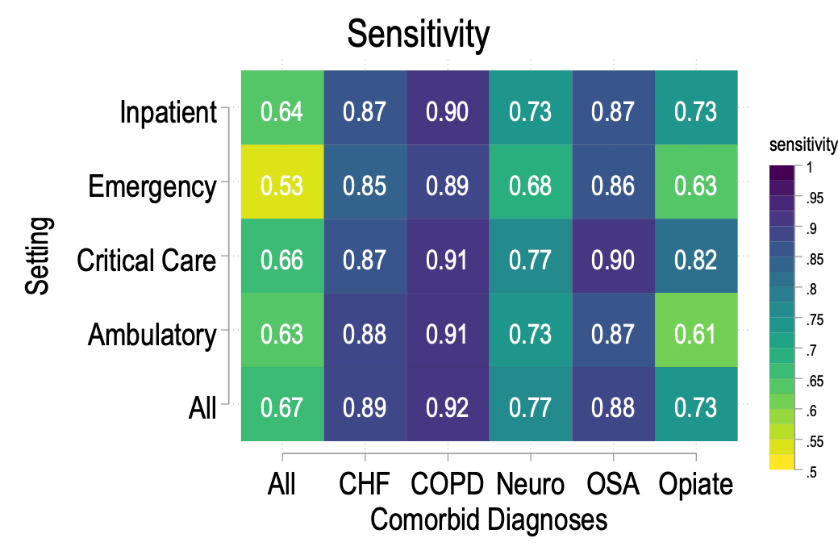
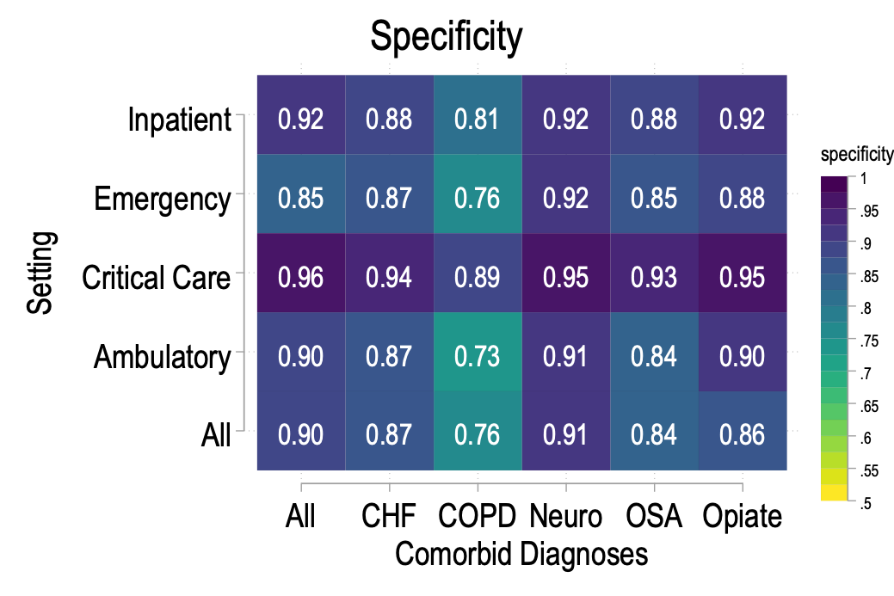
ABG and BMP obtained on the same day
TriNetX: inception to now (~2018)
Categorize by level of care of encounter (Ambulatory, ED, Inpatient, ICU)
Categorize by whether they had received a diagnosis for CHF, COPD, OSA, Neuro, Opiate Use
n=242,298 with paired ABG-BMP | PaCO₂ < 45 mmHg
Age | 65±19 years
Female | 47%
Race/Ethnicity | 17% Black 62% White
HCO₃⁻ ≥ 27 mEq/L | 22% (n=53,3k)
HCO₃⁻ ≥ 27 mEq/L & K⁺ ≥ 4.0 mEq/L | 15% (n=36.3k)
PaCO₂ ≥ 45 mmHg | 23% (n=55.7k)
 | HCO₃⁻ ≥ 27 mEq/L (& K ≥ 4.0 mEq/L) | HCO₃⁻ < 27 mEq/L (or K < 4.0 mEq/L)
PaCO₂ ≥ 45 mmHg | True Positive | False Negative
PaCO₂ < 45 mmHg | False Positive | True Negative
Accuracy of ↑HCO3- only to predict ↑PaCO2
*Spectrum Bias; Thresholds

Slide 41
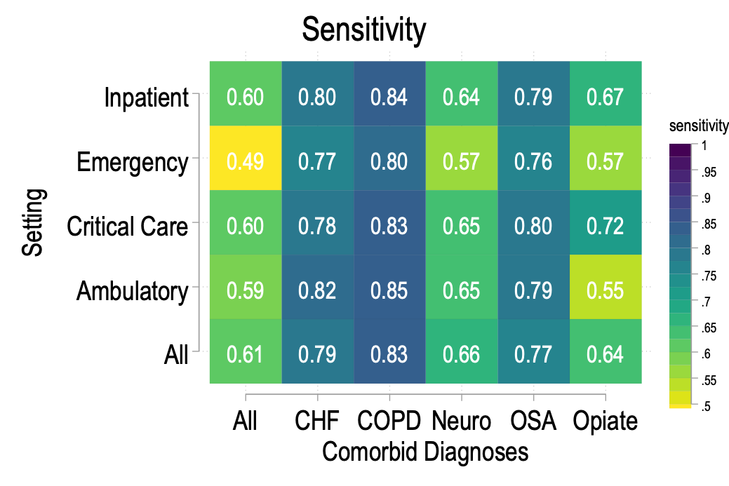
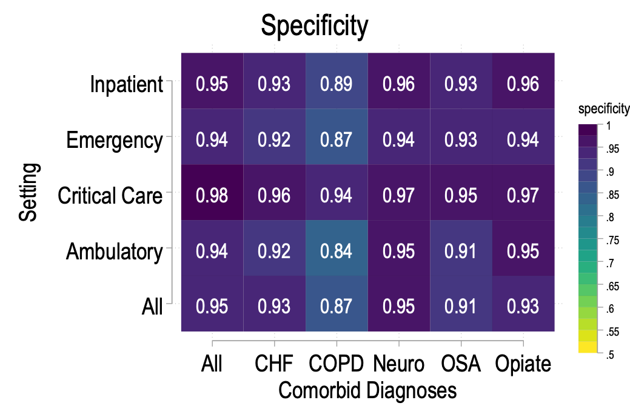
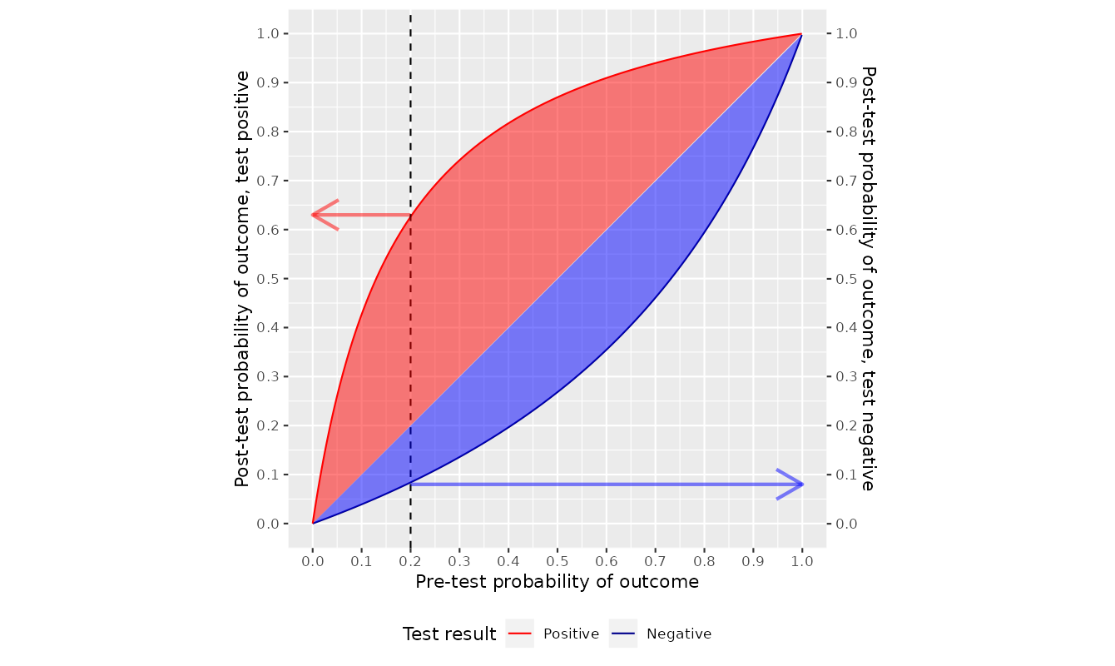
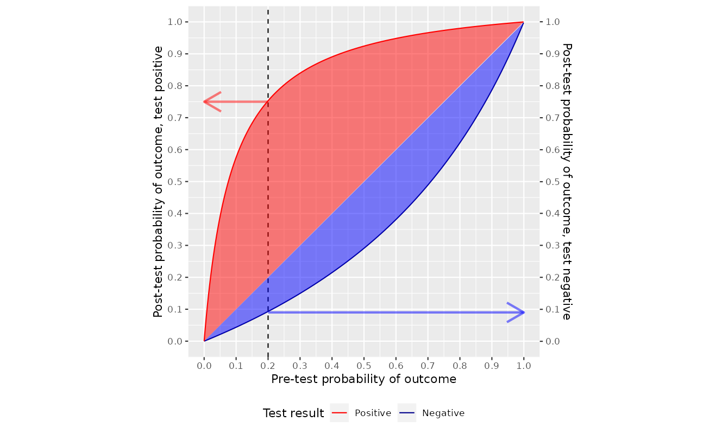
Adding potassium ≥ 4.0 mEq/L criterion
Accuracy of ↑HCO3- only to predict ↑PaCO2
Adding potassium ≥ 4.0 mEq/L criterion
Notes:
Obviously, the physiology of acid-base compensation is well described.
Thus – this is a pragmatic study to assess IN REALITY how often the following factors influence
Time-course of hypercapnia
Prevalence of impaired renal compensation
Frequency of concurrent metabolic disturbances

Slide 42
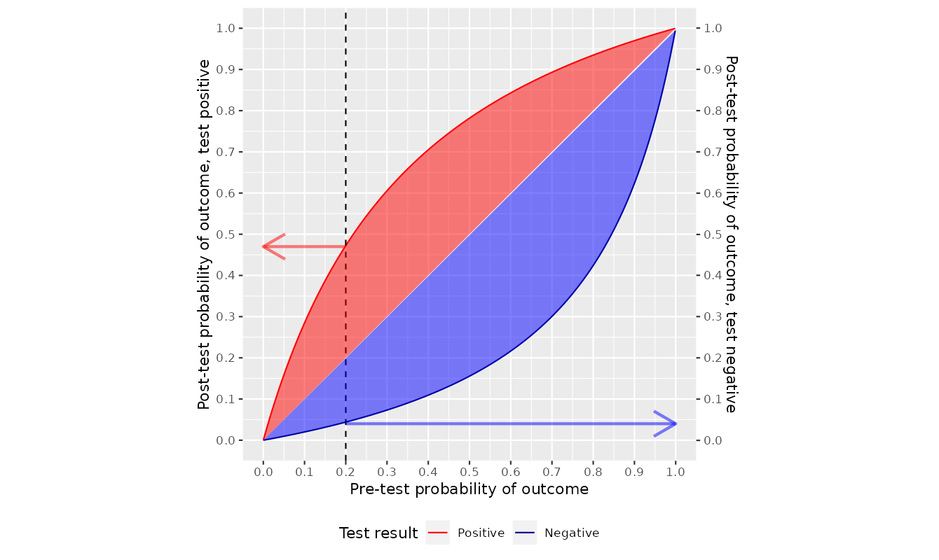
SRMA: Use of HCO3- in a outpatient sleep study center: different characteristics.

Slide 43
Can you combine different data-elements?
Aim: identify hypercapnia to a certain threshold probability
Bayes theorem:
LR = represents informativeness of a test
(↑)Pretest * (↓)LR = (no 𝚫) Posttest
Regardless of specific threshold
To assess accuracy: need a “ground truth”: What to use when ABG not obtained?
Many conditions: ”clinician review”, not possible nor feasible
Proposal: Inverse probability of ABG weigting.

Slide 44
CO2
35
35
35
35
Inverse Probability (of Testing) Weighting to create a pseudopopulation approximating if everyone had an ABG
35
35
35
55
To simplify, imagine everyone is either not-hypercapnic (PaCO2 = 35) or hypercapnic (PaCO2 = 55)
35
35
55
55
55
55
55
55
55
55
P(Hypercap | Blue) = 1/3
P(Hypercap | Red) = 2/3
Notes:
Not quite right.. Need relationship between PaCO2 and sampling

Slide 45
CO2
P(ABG)
Inverse Probability (of Testing) Weighting to create a pseudopopulation approximating if everyone had an ABG
35
2/3
35
2/3
35
1/3
35
1/3
35
2/3
35
2/3
35
1/3
55
1/3
To simplify, imagine everyone is either not-hypercapnic (PaCO2 = 35) or hypercapnic (PaCO2 = 55)
35
2/3
35
2/3
55
1/3
55
1/3
Imagine we know (or perfectly model) the propensity of different types of people to get ABGs
55
2/3
55
2/3
55
1/3
55
1/3
55
2/3
55
1/3
P(ABG | Blue) = 2/3
P(ABG | Red) = 1/3
P(Hypercap | Blue) = 1/3
P(Hypercap | Red) = 2/3
Notes:
Not quite right.. Need relationship between PaCO2 and sampling

Slide 46
CO2
P(ABG)
35
2/3
35
2/3
35
1/3
35
1/3
Who actually gets an ABG?
(in real life, there would be some noise)
35
2/3
35
2/3
35
1/3
55
1/3
35
2/3
35
2/3
55
1/3
55
1/3
55
2/3
55
2/3
55
1/3
55
1/3
55
2/3
55
1/3
P(ABG | Blue) = 2/3
P(ABG | Red) = 1/3
P(Hypercap | Blue) = 1/3
P(Hypercap | Red) = 2/3
Notes:
Not quite right.. Need relationship between PaCO2 and sampling

Slide 47
CO2
P(ABG)
Unweighted Analysis
35
2/3
35
2/3
35
1/3
35
1/3
55
1/3
55
1/3
2 of 18 have documented CO2 > 45
35
2/3
35
2/3
35
1/3
55
1/3
55
2/3
55
2/3
2 of 18 have documented CO2 > 45
35
2/3
35
2/3
55
1/3
55
1/3
55
2/3
55
2/3
55
1/3
55
1/3
Calculated Relative Risk: 1
55
2/3
55
1/3
P(ABG | Blue) = 2/3
P(ABG | Red) = 1/3
P(Hypercap | Blue) = 1/3
P(Hypercap | Red) = 2/3
Actual Relative Risk: 2
Notes:
Not quite right.. Need relationship between PaCO2 and sampling

Slide 48
CO2
P(ABG)
Weighted Analysis
35
2/3
35
2/3
35
1/3
35
1/3
Weight = Inverse of propensity
Blue = 1.5
Red = 3
35
2/3
35
2/3
35
1/3
55
1/3
55
1/3
55
1/3
55
1/3
55
1/3
35
2/3
35
2/3
55
1/3
55
1/3
55
1/3
55
1/3
==
55
2/3
55
2/3
55
1/3
55
1/3
55
2/3
55
2/3
55
1/3
55
1/3
55
2/3
55
1/3
55
2/3
55
2/3
55
2/3
P(ABG | Blue) = 2/3
P(ABG | Red) = 1/3
P(Hypercap | Blue) = 1/3
P(Hypercap | Red) = 2/3
Actual Relative: 2
Notes:
Not quite right.. Need relationship between PaCO2 and sampling

Slide 49
‘Silver’ Standard: Inverse Probability (of ABG) Weighted PaCO2
Intuition behind the propensity weighted ‘pseudopopulation’:
If a patient has the finding, but was unlikely to get the test: there are probably many more out there that aren’t captured.
It is a valid approximation to the extent that:
Observations are independent and identically distributed 👍
Overlap: some possibility that each patients might have/not get an ABG 👍
Conditional independence: after account for all the covariates, there is no longer an association between the P(ABG) and P(PaCO₂ > 45) 👎
To the extent we can capture the reasons for chance variation in the propensity score, it will improve estimation of the features associated with hypercapnia (if an ABG had been checked in everyone)
Notes:
Patient X has a PaCO₂ > 45 mmHg
Based on what we know about Patient X, they were very unlikely to have an ABG checked.
Then, there are likely many more patients like X who would have had a PaCO2 > 45 mmHg if it was checked… but it wasn’t.
If you weight all patients (including X) so that they represent the patients who did not have an ABG checked, the ‘pseudopopulation’ approximates if everyone had received an ABG
Note: I’m not trying to describe some law of nature – just trying to make an algorithm that works better.
No trends in PaCO2 levels. One person having a CO2 level that’s high doesn’t make another high
Note: you don’t have to capture everything that influences the likelihood of someone getting an ABG, just everything that influences likelihood of obtain an ABG at a certain PaCO2
This takes advantage of the data-elements in TriNetX (lots) and uses it to generate better “reference standards” to use with the data-elements that are more commonly present.

Slide 50
LASSO Ordinal logistic regression(s)
(API & published regression equation)
Problem: many possible predictors: which ones do you choose?
Take a set of ~10-15 physio/sociologically plausible predictors
LASSO: most parsimonious set of predictors to allow for a categorical probabilistic assessment of hypercapnia (within 24h of admission) if it were checked.
Separate model for diagnostic codes only (expect lower discriminative ability)
Separate model including lab values (EHR data-set)
Age
BMI Sex
Dx Hypercap. RF?
Dx Any Resp Failure?
COPD?
Etc..
HCO3
Cl-
Etc..
VBG? PCO2___; pH
ABG? PCO2___; pH
…
Very High Probability (90%+) of hypercapnic RF
Notes:
(cross validation to determine penalty = number of features; LARS to account for computation.)

Slide 51
Will it work? Validation
Retrospective Validation in an independent data set (Acute, Chronic)
Collaborators EHR, or MIMIC etc.
Retrospective Validation at U of U with elevation correction
Prospective K23 Grant Application: obtain SennTec TcCO2 (95% LOA: +/- 7mmHg) on a random sample of patients admitted and predicted to various levels of PaCO2 probability. 3 Aims Addressed
Does the identification algorithm work?
What happens to the hypercapnic patients? (cohort, care processes)
How well do clinicians do at identification? (and does it matter?)
Grant Writing Fall 2023; Aim for Feb 2024 NIH Grant Cycle
Notes:
Step 1: Model likelihood of of Hypercapnia: Ordinal Logistic Regression; Cross-validate in the data-set
Step 2: Externally validate in other EMR data
Step 3: Prospectively validate – Senntec LOA +/- 7 mmHg
Other benefits: create a cohort [what happens to them, who are they?]; evaluate the impact of ‘unrecognized’ hypercapnia?

Slide 52



Questions? Comments

